Slide 1
Placenta Problems
And
Unsightly Uteruses

Slide 2
PROM/placenta previa/abruption/uterine rupture, Ultrasound of the pregnant patient
Present a personal case regarding 2nd trimester bleeding or ectopic pregnancy
Review the above conditions, specifically with pictures of both ultrasound findings and pelvic exam findings
Include how to diagnose and manage the above
Which rooms in our ER have fetal monitoring capabilities?
What to look for on transabdominal/transvaginal ultrasound in a pregnant patient
What to look for in ectopic pregnancy on ultrasound
Show a video/still images

Slide 3
Ultrasound evaluation of pregnant patient
https://www.youtube.com/watch?v=CH4m-EaTGjw&t=1m30s

Slide 4
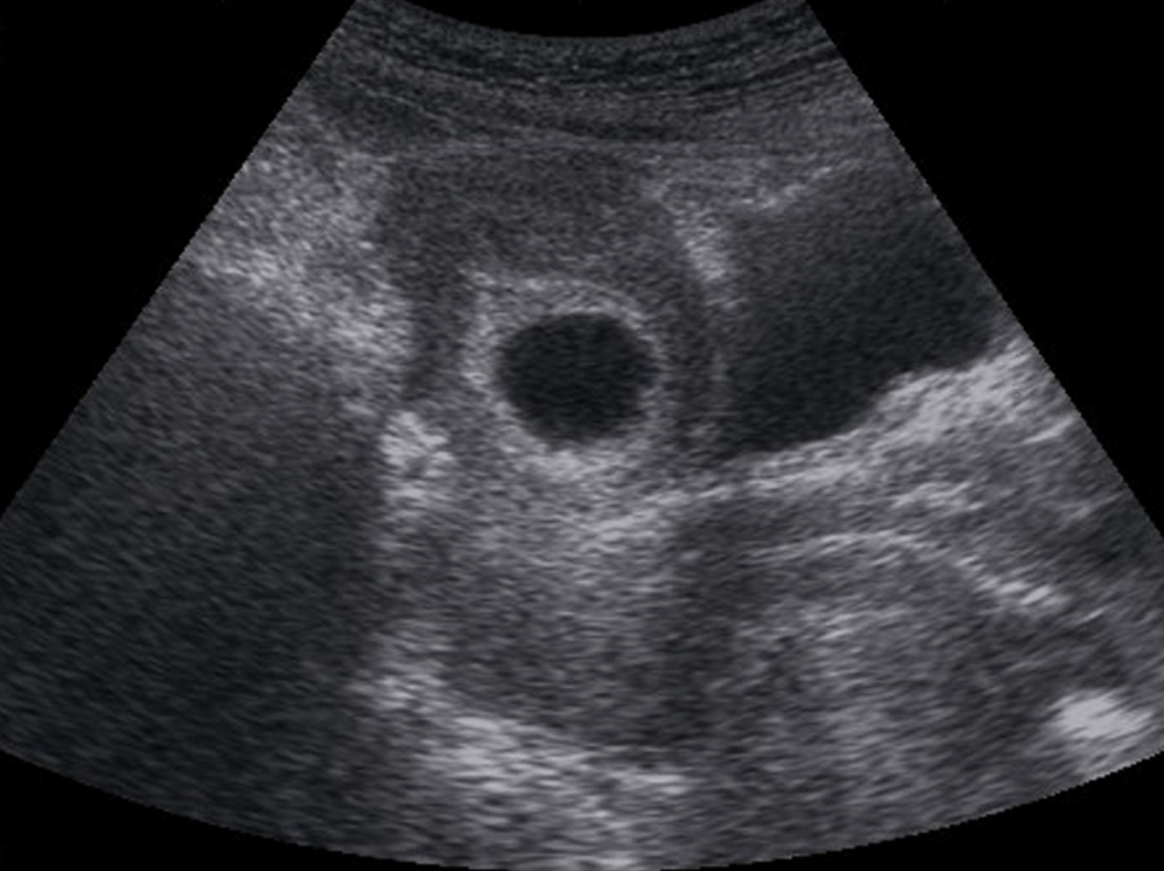

Slide 5
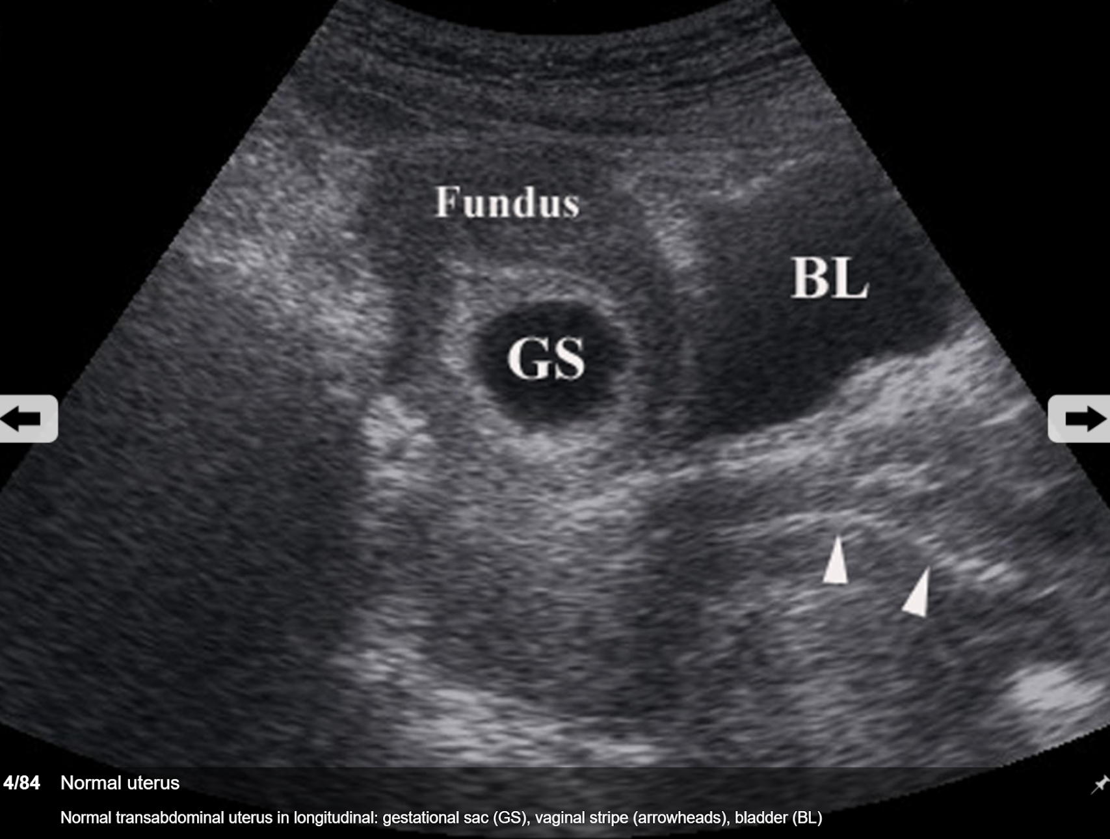

Slide 6
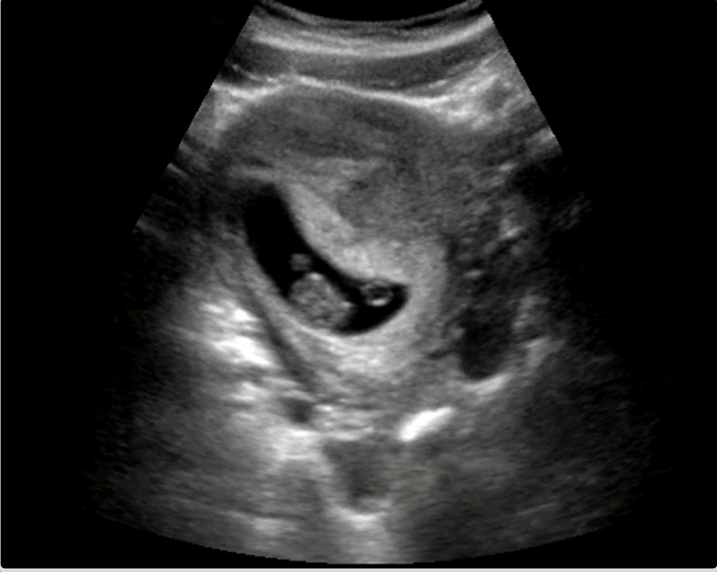

Slide 7
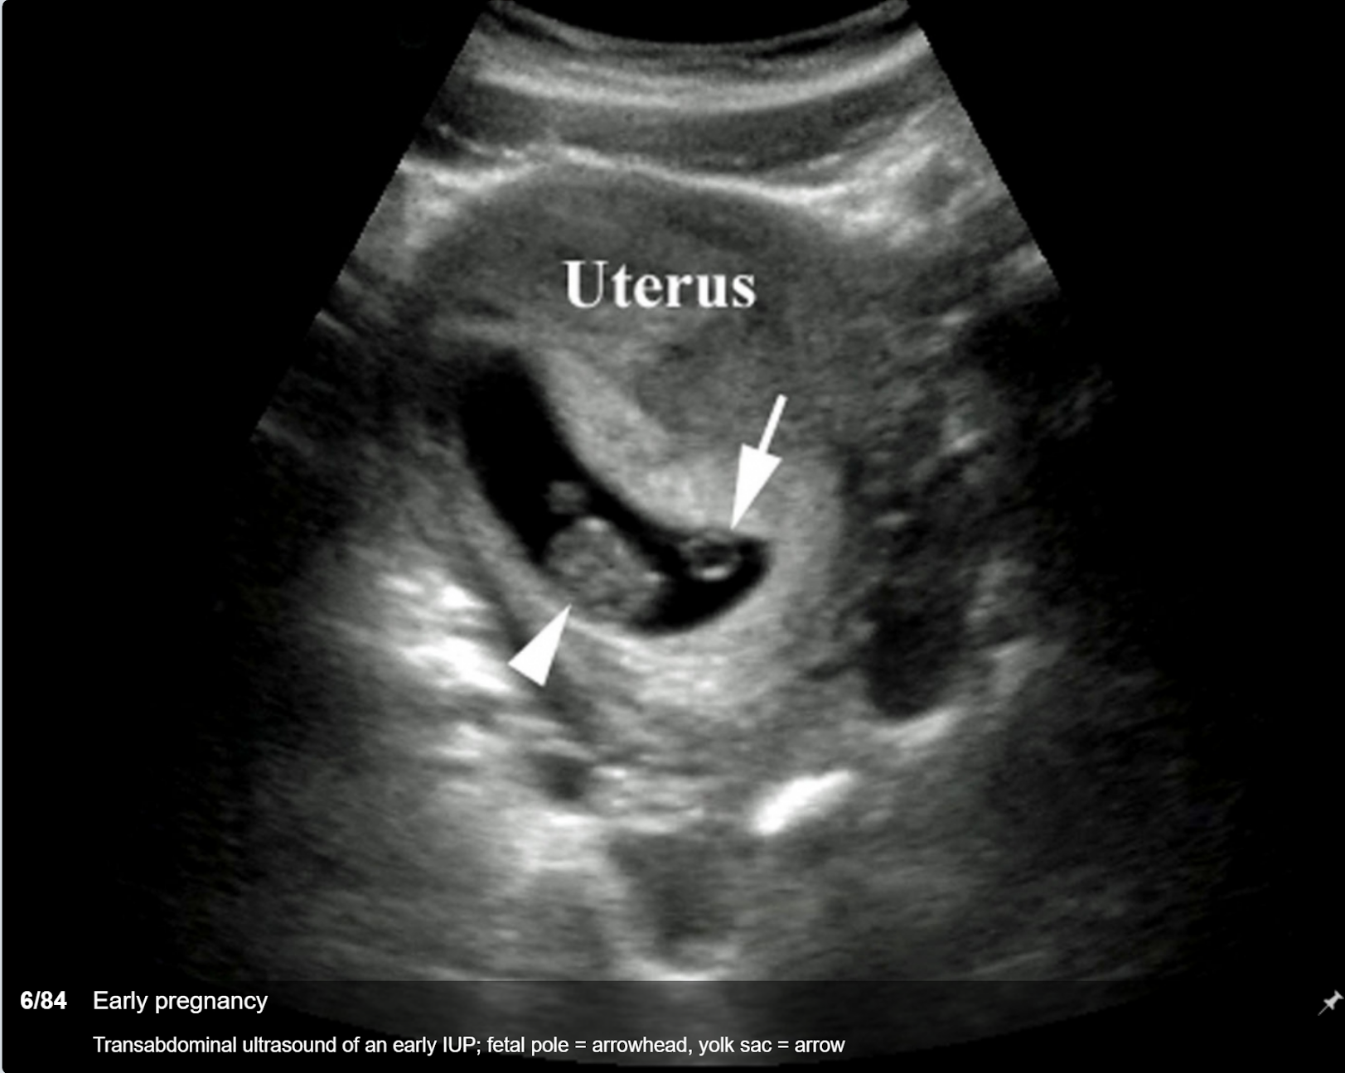

Slide 8
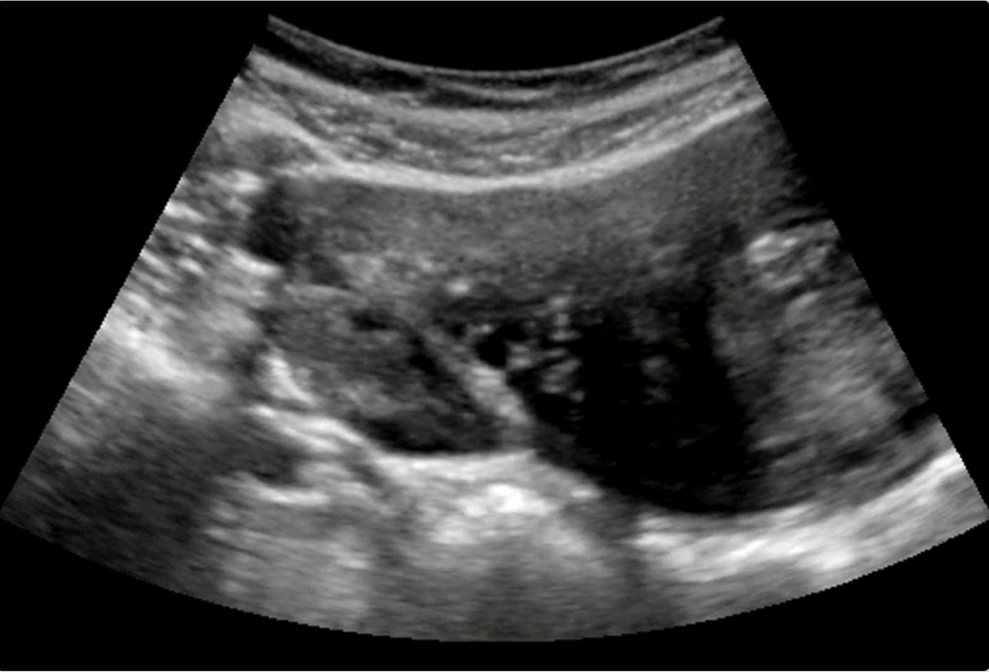

Slide 9
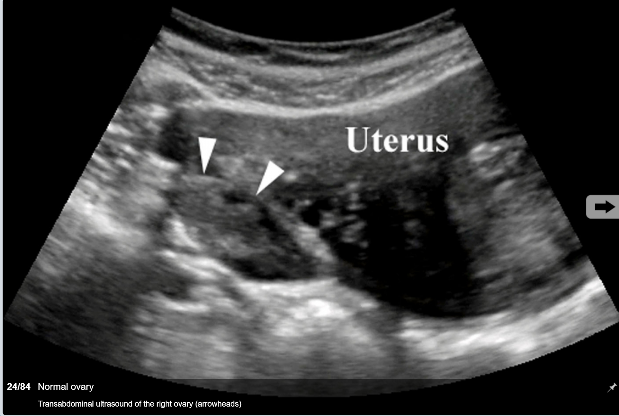

Slide 10
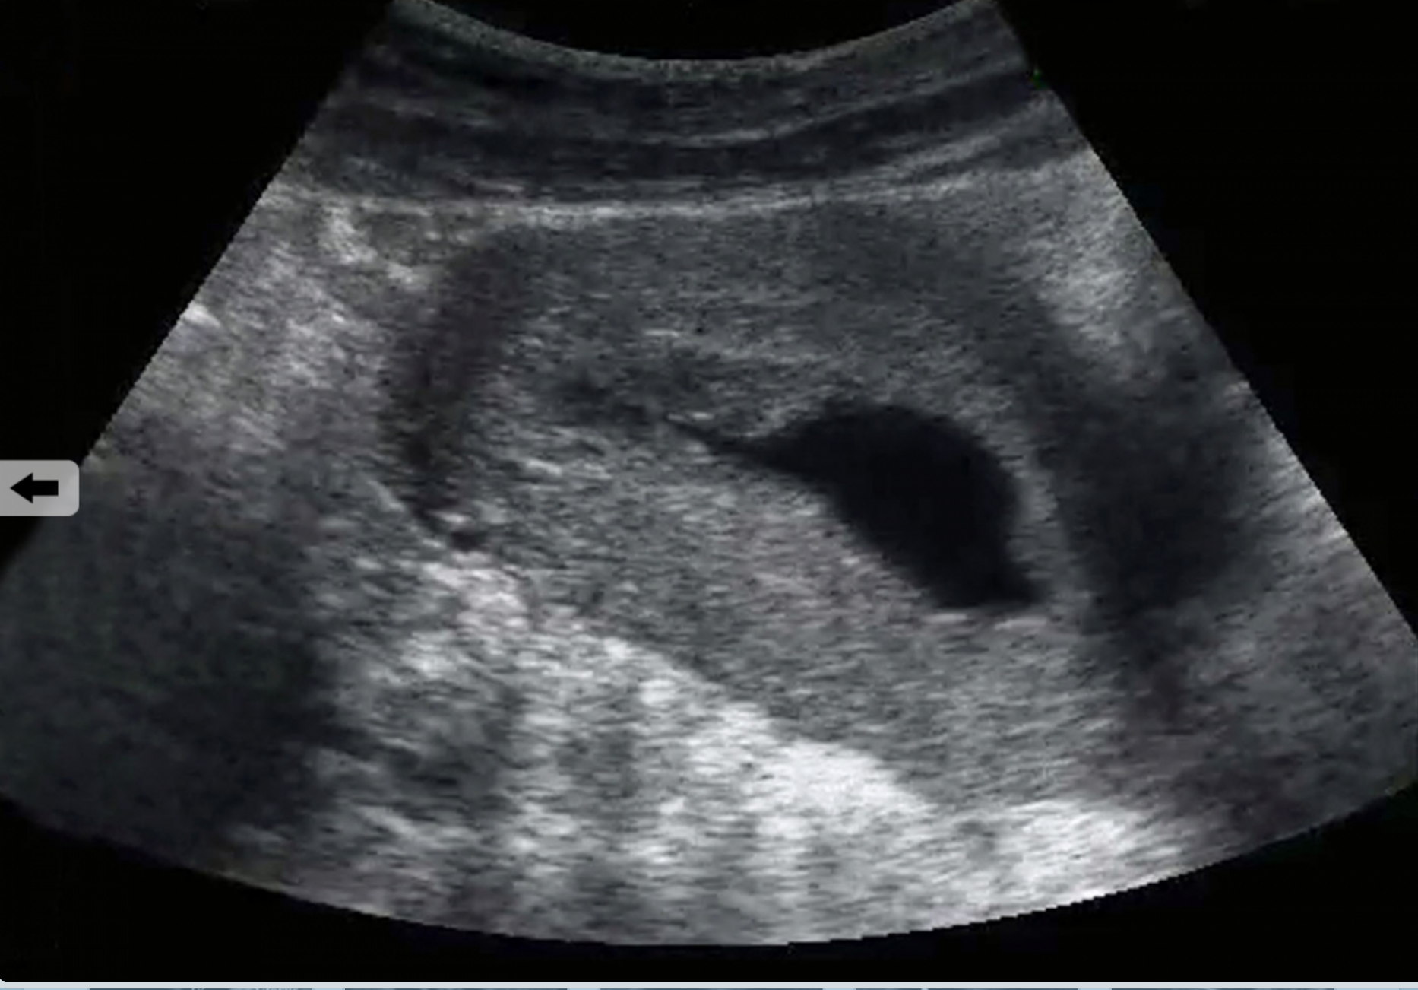

Slide 11
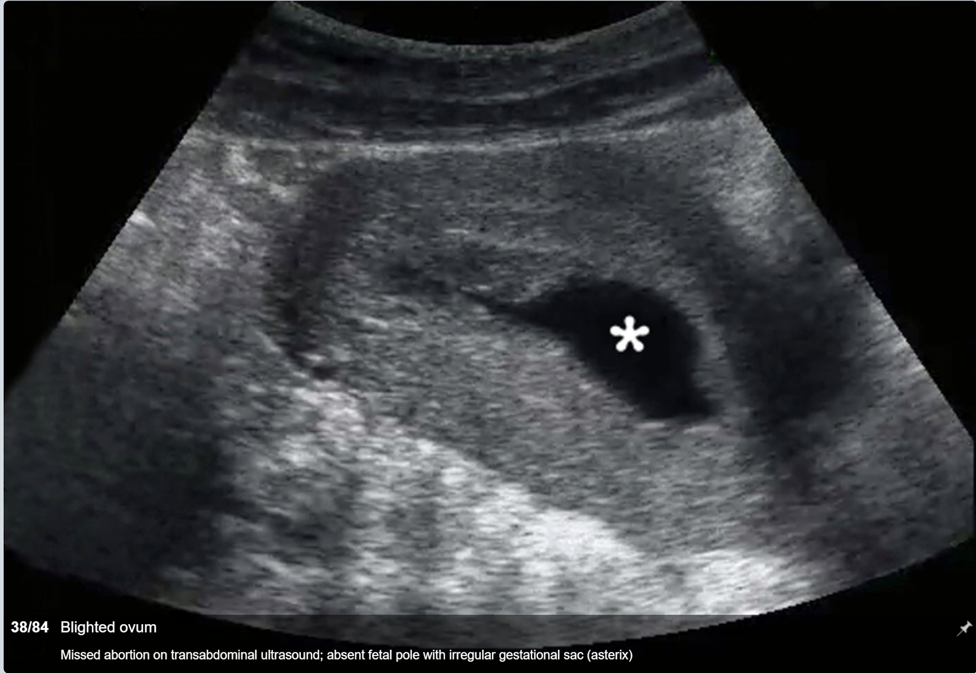

Slide 12
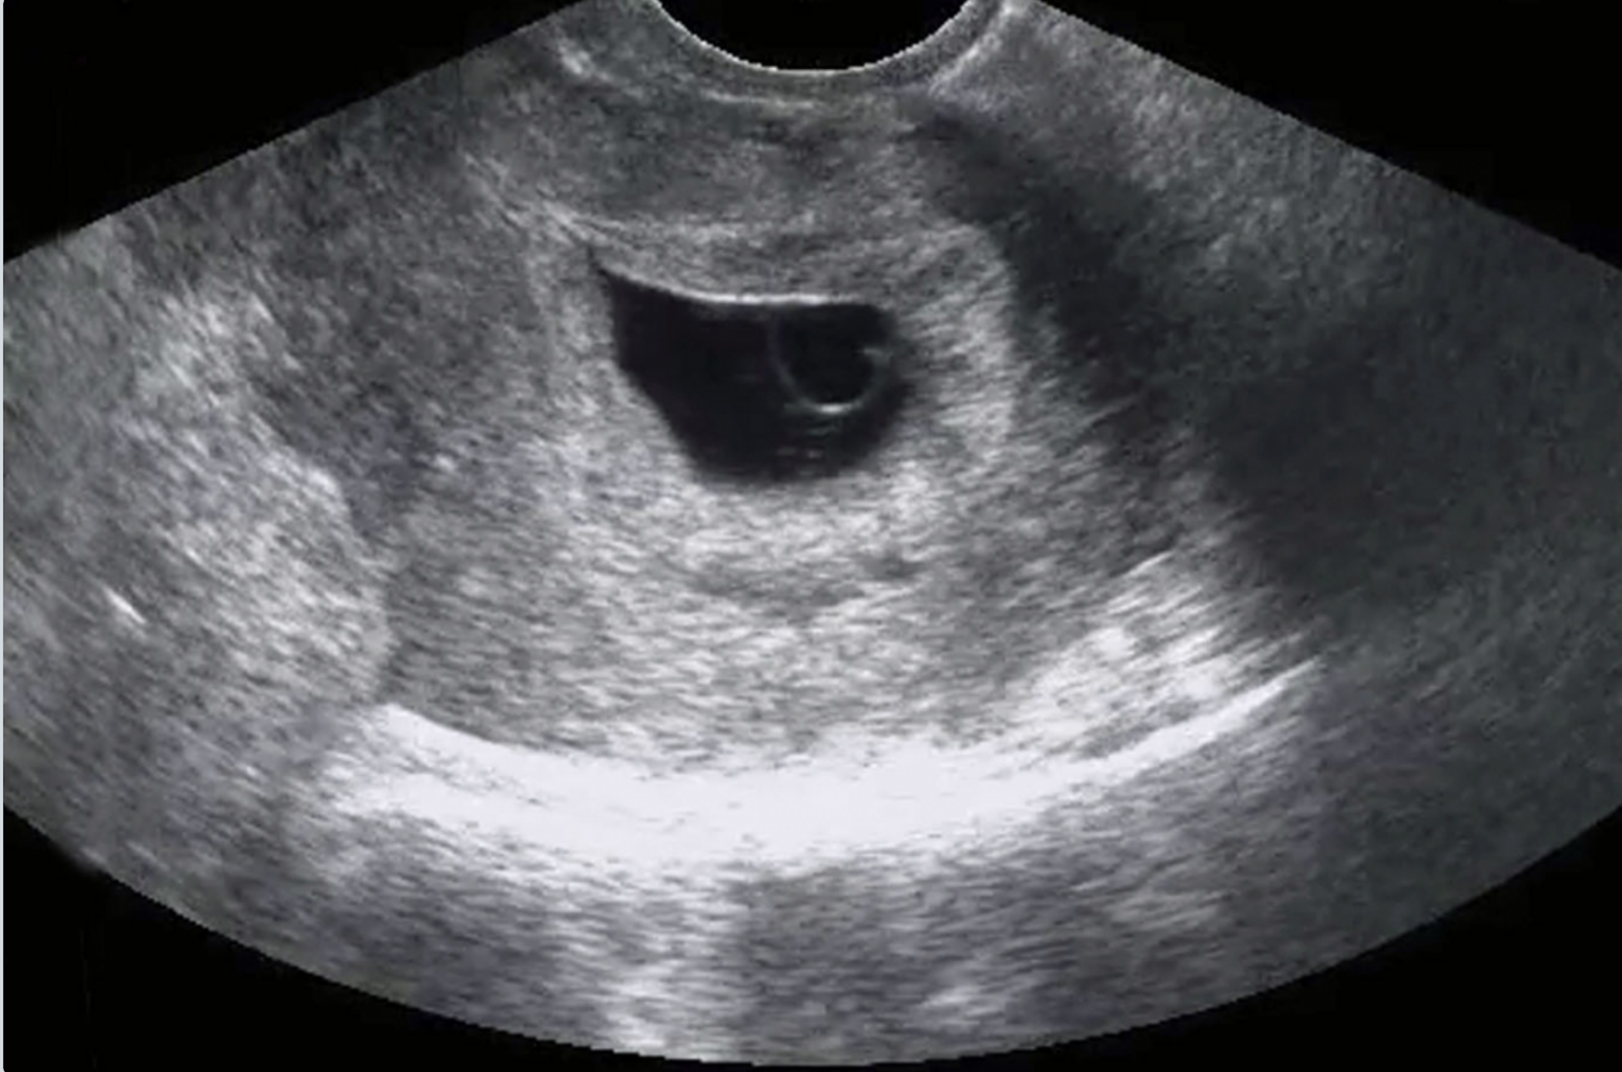

Slide 13
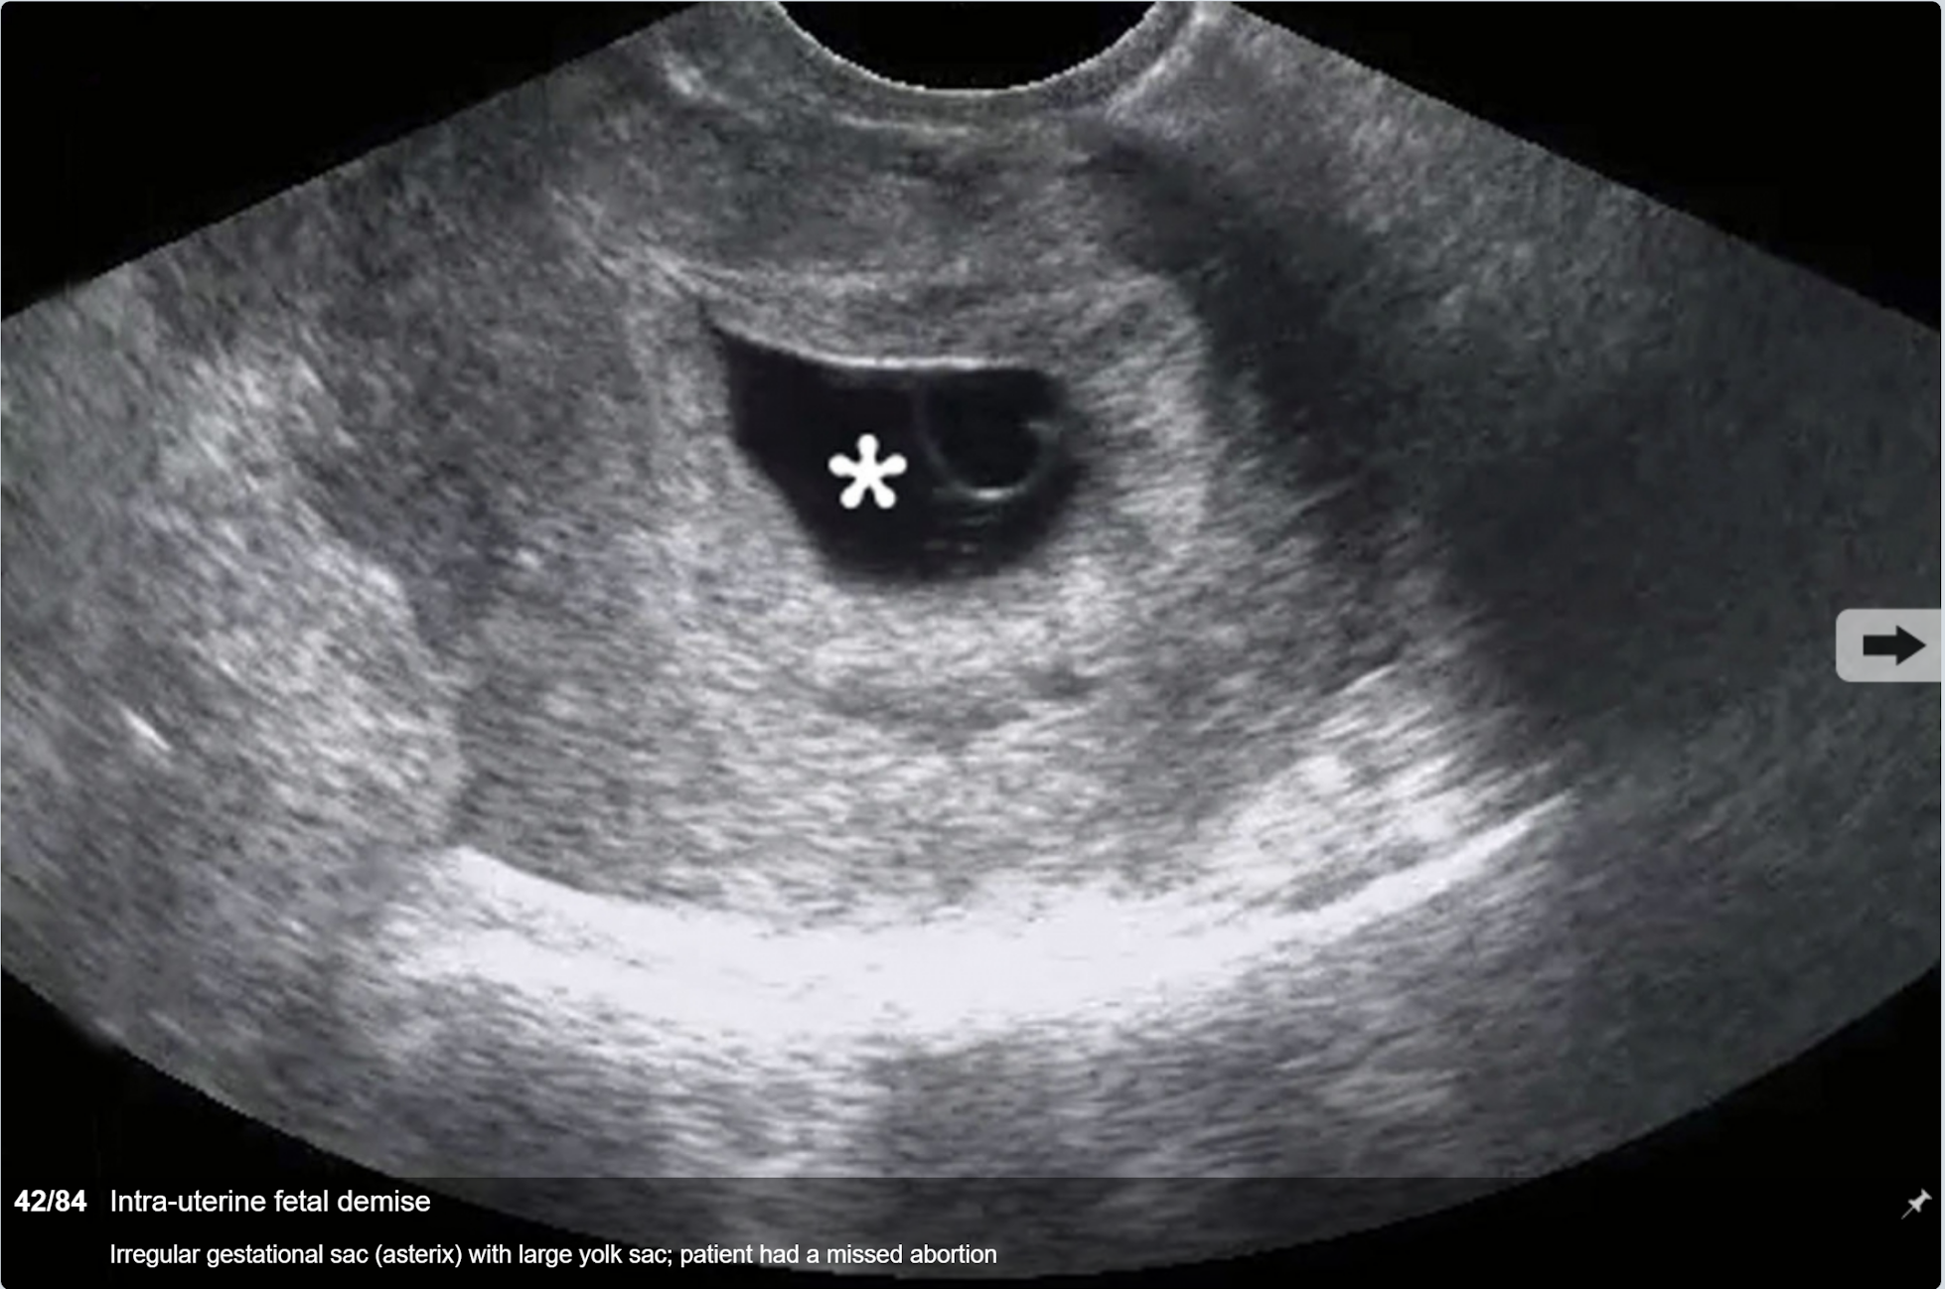

Slide 14
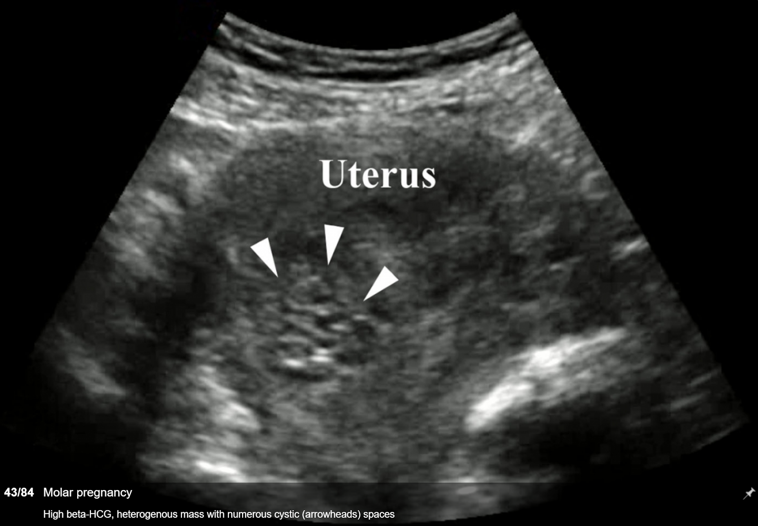

Slide 15
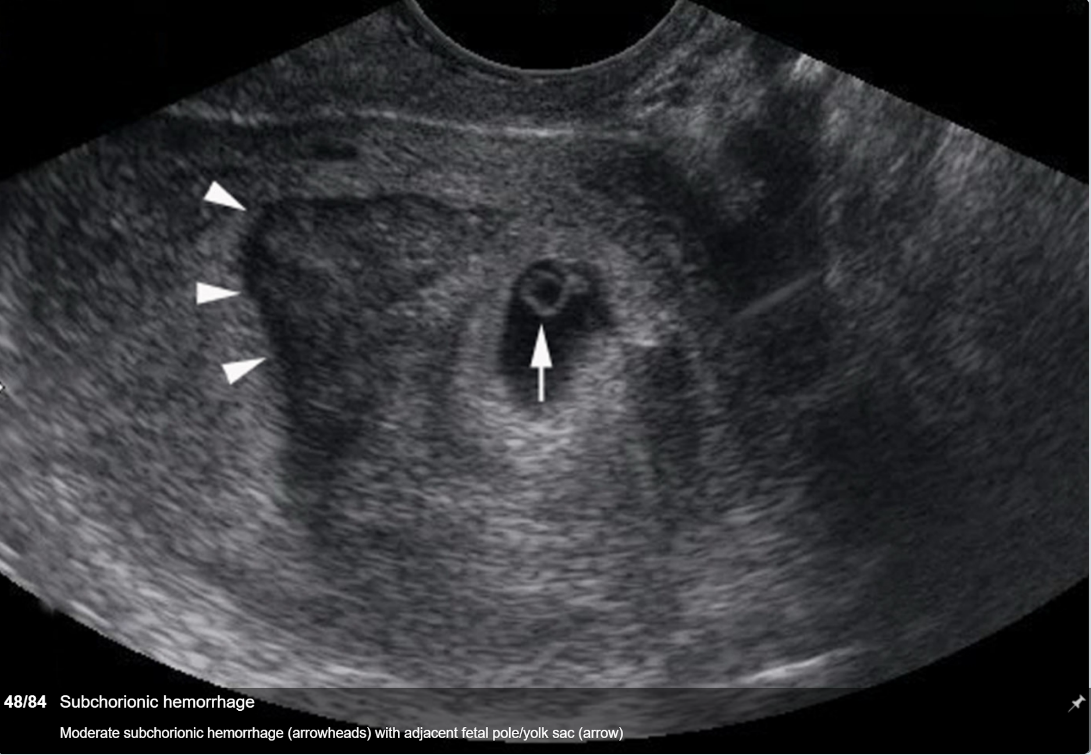

Slide 19
Case
19 y/o AA female presents to ED ℅ lower abdominal pain and vaginal bleeding going on since this am, pain is worse than her normal period cramps.
VSS, Tenderness over the left pelvis, on speculum/bimanual patient has significant CMT, there is minimal bleeding from the cervical os.
Urine HCG positive, US reveals left adnexal mass, no free fluid
Patient went to OR for salpingectomy

Slide 20
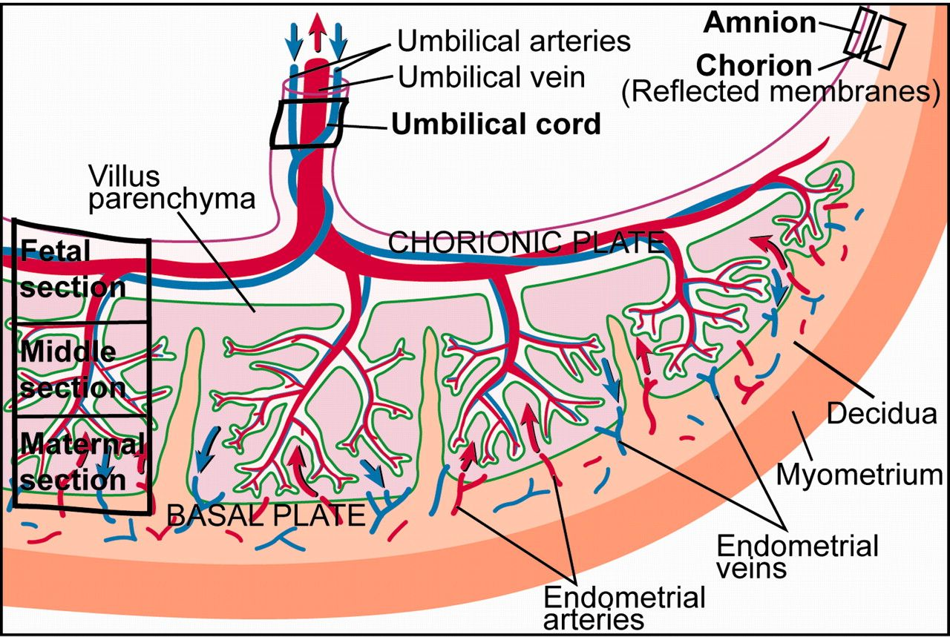

Slide 21
Vaginal bleeding late in pregnancy
Medical Problems?
Painful or Painless?
Previous Imaging?
Fetal movement?
Trauma?

Slide 22
29 y/o female, G5P4, 25 weeks pregnant presents to the ED complaining of severe lower abdominal pain.
PMHx: HTN, Obesity
Vitals: HR: 120, BP: 90/50, T: 98.6: O2Sat:98%

Slide 23
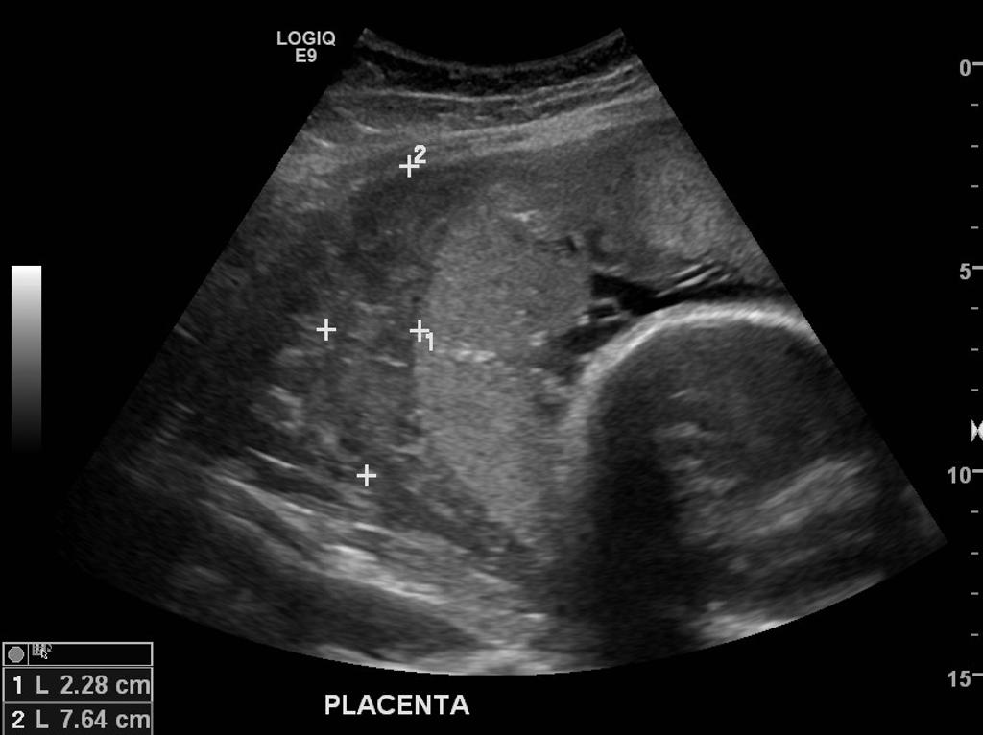

Slide 24
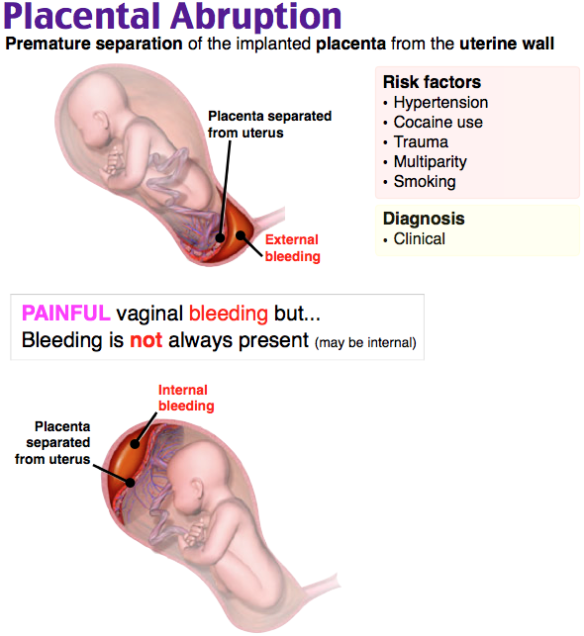

Slide 25
Treatment
ABCs
Cardiotocographic monitoring
OB consult
Resuscitation, two large bore IVs
Labs: CBC, CMP, Coags, Fibrid degradation product, Fibrinogen levels, Type and cross match
Give Rhogam for Rh negative.
Replaced coagulation factors for DIC
Delivery if abruption is severe

Slide 26
35 y/o female G2P1, 33 weeks pregnant, will be attempting VBAC at full term. Presents complaining of vaginal bleeding. Denies any pain
VSS
Physical exam?

Slide 27
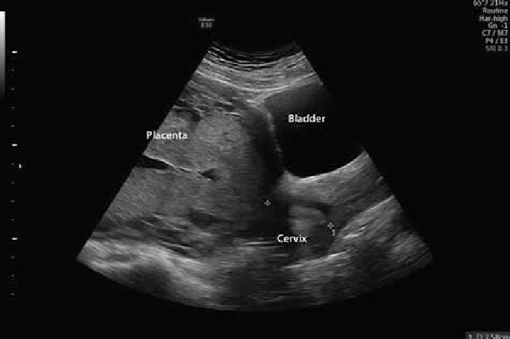

Slide 28
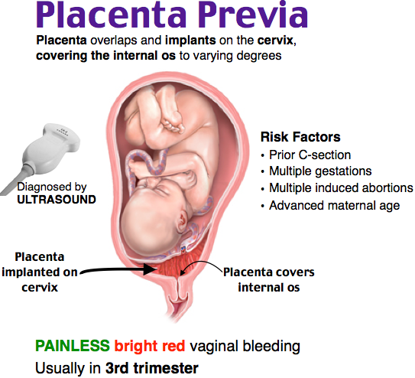

Slide 29
Treatment
ABCs
Resuscitation, two large bore IVs
Labs: CBC, Coags, Type and cross match
Give Rhogam for Rh negative.
Cardiotocographic monitoring
DO NOT PERFORM SPECULUM OR BIMANUAL EXAM UNTIL NORMAL PLACENTA POSITION DETERMINED BY ULTRASOUND
OB consult
Usually admitted for observation and fetal monitoring.

Slide 30
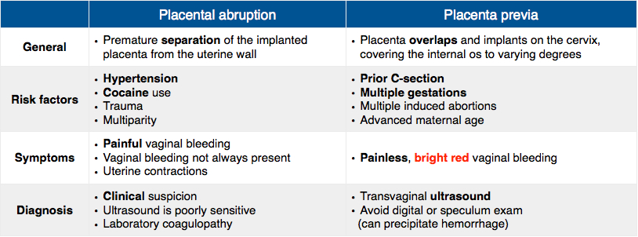
Placenta Problems

Slide 31
27 y/o female G3P2 37 weeks pregnant, with two C-sections in the past presents to the ED with complaints of labor. She had a large gush of fluids at home, contractions were becoming stronger and more frequent, en route to the hospital she had terrible lower abdomen pain and now contractions seem to have stopped.
VSS: P: 119, BP: 82/45
Exam: Abdominal exam: can clearly palpate the leg of a fetus

Slide 32
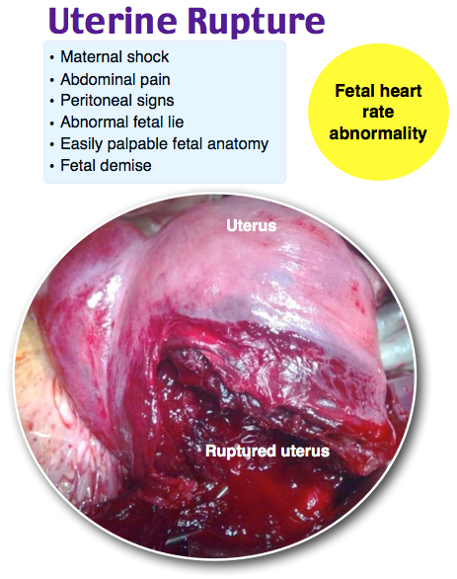

Slide 33
Treatment
ABCs
Fluid/Blood resuscitation
Definitive OB care
Fetal mortality/morbidity is proportional to the degree of expulsion

Slide 34
24 y/o female G1P0, 32 weeks pregnant presents to ED complaining of large gush of fluid, no CTX at the moment, no fevers, no other complaints
VSS
What tests would you like to do?

Slide 35
Premature Rupture of Membranes
Pretrerm Premature ROM - membrane rupture before 37 weeks of gestation
Avoid digital cervical examination, decreases latent period and increases infection risk.
Diagnosed with nitrazine paper, fern testing

Slide 36
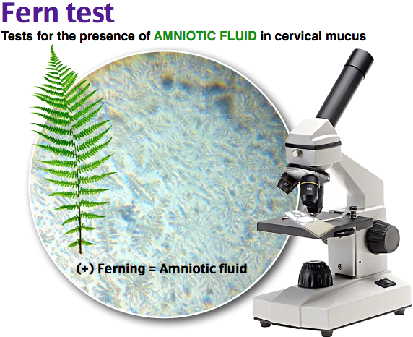

Slide 37
Treatment
Obstetric consultation
Corticosteroids if less than 34 weeks
Antibiotics to treat Group B Strep
Penicillin G, Ampicillin, and Cefazolin
Guidelines for delivery vary, no difference in risk of neonatal sepsis with immediate delivery of PPROM at greater than 34 weeks gestation.

Slide 38
Question 1
A 36-year-old woman presents to the ED with sudden onset lower abdominal pain and vaginal bleeding. She is 35-weeks pregnant. She reports constant lower abdominal pain and vaginal bleeding for the last 4 hours. On examination, her cervix is closed and she has dark blood coming from the cervical os. Her uterus is firm to the touch. What is the most common risk factor associated with this condition?
Advanced maternal age
Cocaine use
Hypertension
Tobacco use

Slide 39
Question 1
A 36-year-old woman presents to the ED with sudden onset lower abdominal pain and vaginal bleeding. She is 35-weeks pregnant. She reports constant lower abdominal pain and vaginal bleeding for the last 4 hours. On examination, her cervix is closed and she has dark blood coming from the cervical os. Her uterus is firm to the touch. What is the most common risk factor associated with this condition?
Advanced maternal age
Cocaine use
Hypertension
Tobacco use

Slide 40
Question 2
A 36-year old woman presents with lower abdominal pain and vaginal bleeding. Her pregnancy test is positive. She is clammy and diaphoretic with a blood pressure of 90/40 mm Hg and a heart rate of 128 beats per minute. She is tender in the left lower quadrant with guarding. Pelvic ultrasound shows a left ovarian mass with free fluid in the pelvis, as well as an approximately 7-week intrauterine pregnancy. What is the most common cause of this condition?
History of sexually transmitted infection
Infertility treatment
Intrauterine device use
Previous ectopic pregnancy

Slide 41
Question 2
A 36-year old woman presents with lower abdominal pain and vaginal bleeding. Her pregnancy test is positive. She is clammy and diaphoretic with a blood pressure of 90/40 mm Hg and a heart rate of 128 beats per minute. She is tender in the left lower quadrant with guarding. Pelvic ultrasound shows a left ovarian mass with free fluid in the pelvis, as well as an approximately 7-week intrauterine pregnancy. What is the most common cause of this condition?
History of sexually transmitted infection
Infertility treatment
Intrauterine device use
Previous ectopic pregnancy

Slide 42
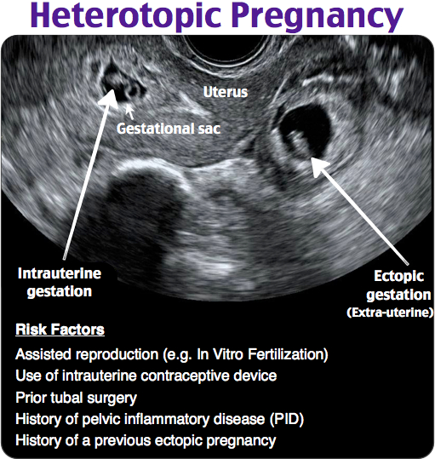

Slide 43
Question 3
A 26-year old 36-week pregnant woman presents to the ED with a complaint of vaginal bleeding. She denies associated cramping, abdominal pain or preceding traumatic event. She describes the blood as “bright red.” Which of the following is a risk factor for development of this condition?
Previous caesarean section
Previous ectopic pregnancy
Primiparity
Young maternal age

Slide 44
Question 3
A 26-year old 36-week pregnant woman presents to the ED with a complaint of vaginal bleeding. She denies associated cramping, abdominal pain or preceding traumatic event. She describes the blood as “bright red.” Which of the following is a risk factor for development of this condition?
Previous caesarean section
Previous ectopic pregnancy
Primiparity
Young maternal age

Slide 45
Question 4
A 28-year-old woman G1P0 at 38 weeks gestation presents with severe abdominal pain and vaginal bleeding. On examination, the uterus is tetanically contracted and tender to palpation. Fetal monitoring shows decreased heart rate variability and late decelerations. Which of the following is the most likely diagnosis?
Abruptio placentae
Amniotic fluid embolism
Placenta previa
Uterine rupture

Slide 46
Question 4
A 28-year-old woman G1P0 at 38 weeks gestation presents with severe abdominal pain and vaginal bleeding. On examination, the uterus is tetanically contracted and tender to palpation. Fetal monitoring shows decreased heart rate variability and late decelerations. Which of the following is the most likely diagnosis?
Abruptio placentae
Amniotic fluid embolism
Placenta previa
Uterine rupture

Slide 47
Question 5
A 31-year-old woman at 35-weeks gestation presents with brief painless, bright red vaginal bleeding. In addition to fetal monitoring, which of the following is the most important initial management?
Administration of betamethasone to hasten fetal lung maturity
Sterile digital cervical exam
Sterile speculum examination
Transvaginal ultrasound

Slide 48
Question 5
A 31-year-old woman at 35-weeks gestation presents with brief painless, bright red vaginal bleeding. In addition to fetal monitoring, which of the following is the most important initial management?
Administration of betamethasone to hasten fetal lung maturity
Sterile digital cervical exam
Sterile speculum examination
Transvaginal ultrasound

Slide 49
Question 6
Which of the following is the most reliable sign of uterine rupture?
Decrease amplitude of uterine contractions on tocodynamometry
Nonreassuring fetal heart rate
Uterine tenderness
Vaginal bleeding

Slide 50
Question 6
Which of the following is the most reliable sign of uterine rupture?
Decrease amplitude of uterine contractions on tocodynamometry
Nonreassuring fetal heart rate
Uterine tenderness
Vaginal bleeding

Slide 51
Question 7
A 30-year old woman presents complaining of pelvic pain and fever. She had a Cesarean section 3 days prior to presentation at 36 weeks gestation for failure to progress and premature rupture of membranes. Her incision is clean and dry. She is tender in the lower abdomen and foul-smelling lochia is noted during pelvic examination. Which of the following is the most important risk factor in the development of this condition?
Cesarean section
Multiple internal examinations
Premature labor
Premature rupture of membranes

Slide 52
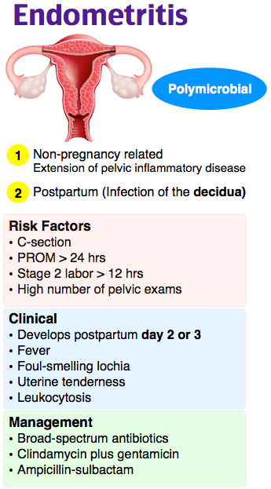

Slide 53
Question 7
A 30-year old woman presents complaining of pelvic pain and fever. She had a Cesarean section 3 days prior to presentation at 36 weeks gestation for failure to progress and premature rupture of membranes. Her incision is clean and dry. She is tender in the lower abdomen and foul-smelling lochia is noted during pelvic examination. Which of the following is the most important risk factor in the development of this condition?
Cesarean section
Multiple internal examinations
Premature labor
Premature rupture of membranes

Slide 54
Question 8
A 28-year-old woman at 31 weeks gestation comes to the emergency department after noticing a gush of clear fluid from her vagina. Which of the following features is most suggestive of preterm rupture of membranes?
Microscopic evaluation of vaginal fluid revealing pseudohyphae
Presence of bloody vaginal secretions
Vaginal epithelial cells with a stippled appearance on microscopic evaluation
Vaginal fluid pH > 6.5

Slide 55
Question 8
A 28-year-old woman at 31 weeks gestation comes to the emergency department after noticing a gush of clear fluid from her vagina. Which of the following features is most suggestive of preterm rupture of membranes?
Microscopic evaluation of vaginal fluid revealing pseudohyphae
Presence of bloody vaginal secretions
Vaginal epithelial cells with a stippled appearance on microscopic evaluation
Vaginal fluid pH > 6.5

Slide 56
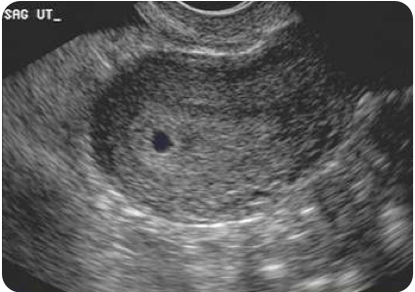
Question 9
A 26-year-old woman presents with abdominal cramping after a positive home pregnancy test. Her vitals are T 98.7°F, HR 94, BP 110/66, RR 18, oxygen saturation 97%. Her exam is unremarkable. Labs reveal a serum beta HCG of 1000 mIU and she is Rh positive. She states that the pregnancy is wanted. An ultrasound is performed as seen above. Which of the following is appropriate management for this patient?
Administer methotrexate
Administer Rhogam and discharge home with repeat beta hCG in 48 hours
Administer Rhogam and methotrexate
Discharge home with repeat beta hCG in 48 hours

Slide 57
Question 9
A 26-year-old woman presents with abdominal cramping after a positive home pregnancy test. Her vitals are T 98.7°F, HR 94, BP 110/66, RR 18, oxygen saturation 97%. Her exam is unremarkable. Labs reveal a serum beta HCG of 1000 mIU and she is Rh positive. She states that the pregnancy is wanted. An ultrasound is performed as seen above. Which of the following is appropriate management for this patient?
Administer methotrexate
Administer Rhogam and discharge home with repeat beta hCG in 48 hours
Administer Rhogam and methotrexate
Discharge home with repeat beta hCG in 48 hours

Slide 58
Question 10
A woman in her third trimester of pregnancy is involved in a motor vehicle collision. She presents to the ED with new onset vaginal bleeding and pelvic pain. Which of the following laboratory abnormalities would you expect to find in this patient?
Decreased prothrombin time
Hypofibrinogenemia
Proteinuria
Thrombocytosis

Slide 59
Question 10
A woman in her third trimester of pregnancy is involved in a motor vehicle collision. She presents to the ED with new onset vaginal bleeding and pelvic pain. Which of the following laboratory abnormalities would you expect to find in this patient?
Decreased prothrombin time
Hypofibrinogenemia
Proteinuria
Thrombocytosis

